Slide 1
Internet Of Things

Slide 2
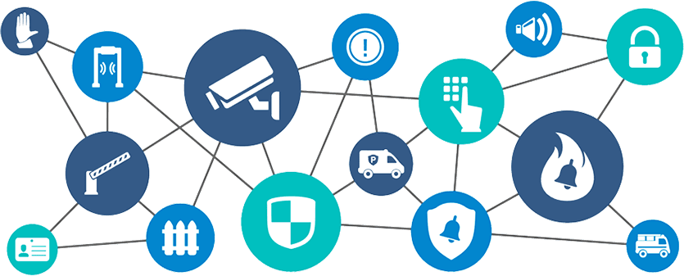
IOT
IoT (Internet of Things) is an advanced automation and analytics system which exploits networking, sensing, big data, and artificial intelligence technology to deliver complete systems for a product or service.

Slide 3
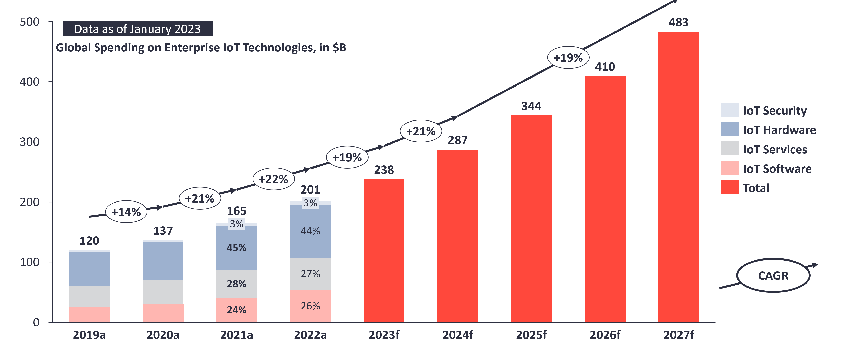
IOT World- Enterprise IoT market

Slide 4
Overall enterprise IoT spending grew 21.5% in 2022 to $201 billion. IoT Analytics lowered the growth outlook for 2023 to 18.5% (from 24% previously).
Macro trends largely dominate the growth expectancy for an otherwise robust digital transformation phase for enterprises.
Lower-than-expected economic growth and general insecurity in 2022 and 2023 lead to cautious spending on digital transformation and IoT.
Tech layoffs largely spared IoT-focused companies.
$201

Slide 5
IOT Architecture

Slide 6
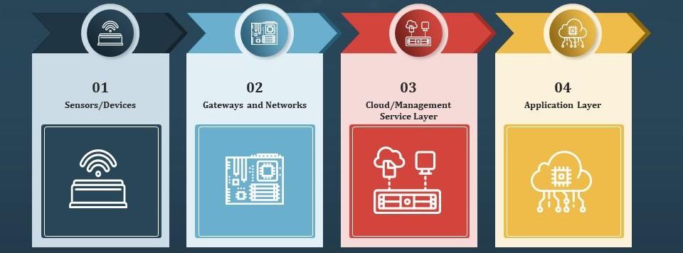
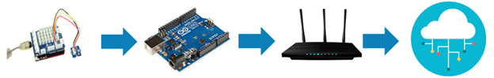
Microcontroller
(Arduino, Raspberry pi, ESP8266)
Any Gateway
Any Sensors
Cloud

Slide 7
Sensors/Actuators: Sensors or Actuators are the devices that are able to emit, accept and process data over the network. These sensors or actuators may be connected either through wired or wireless. This contains GPS, Electrochemical, Gyroscope, RFID, etc. Most of the sensors need connectivity through sensors gateways. The connection of sensors or actuators can be through a Local Area Network (LAN) or Personal Area Network.
Gateways and Data Acquisition: As the large numbers of data are produced by this sensors and actuators need the high-speed Gateways and Networks to transfer the data. This network can be of type Local Area Network (LAN such as Wi-Fi, Ethernet, etc.), Wide Area Network (WAN such as GSM, 5G, etc.).
Edge IT: Edge in the IoT Architecture is the hardware and software gateways that analyze and pre-process the data before transferring it to the cloud. If the data read from the sensors and gateways are not changed from its previous reading value then it does not transfer over the cloud, this saves the data used.
Data center/ Cloud: The Data Center or Cloud comes under the Management Services which process the information through analytics, management of device and security controls. Beside this security controls and device management the cloud transfer the data to the end users application such as Retail, Healthcare, Emergency, Environment, and Energy, etc.

Slide 8
Hardware

Slide 9
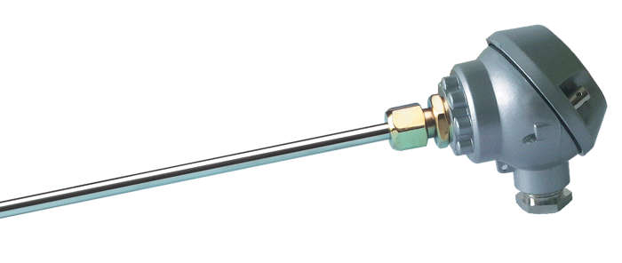
Sensors
The most important hardware in IoT might be its sensors.
These devices consist of energy modules, power management modules, RF modules, and sensing modules. RF modules manage communications through their signal processing, WiFi, ZigBee, Bluetooth, radio transceiver, duplexer, and BAW.
Types of sensors - accelerometers, temperature sensors, magnetometers, proximity sensors, gyroscopes, image sensors, acoustic sensors, light sensors, pressure sensors, gas RFID sensors, humidity sensors, micro flow sensors.

Slide 10
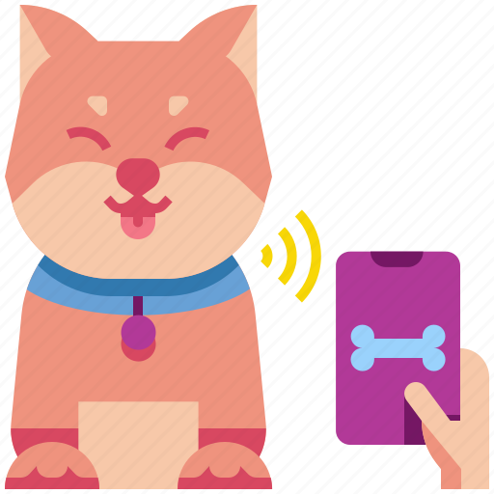
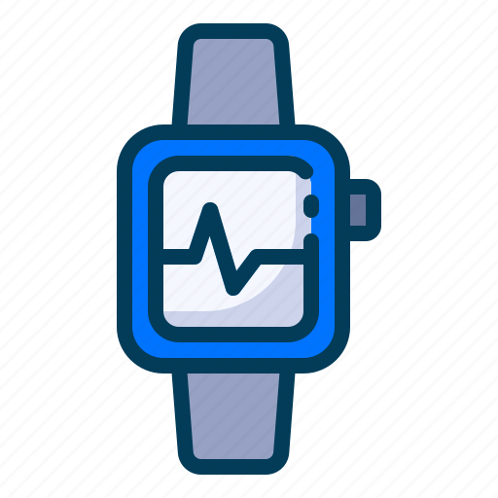
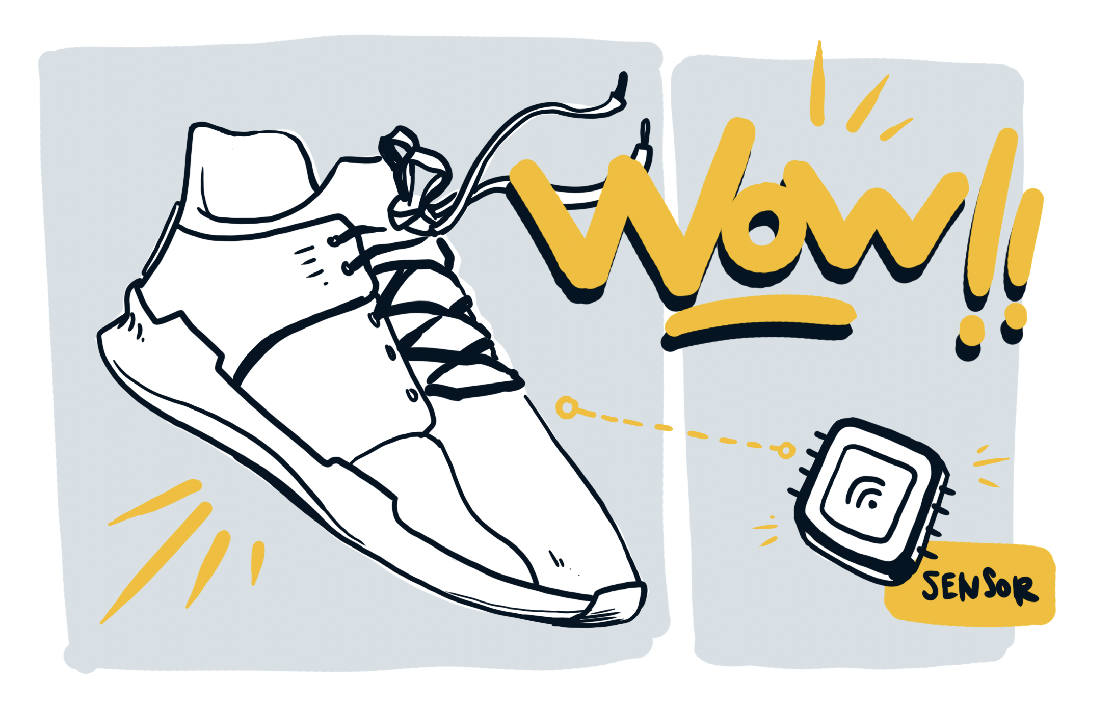
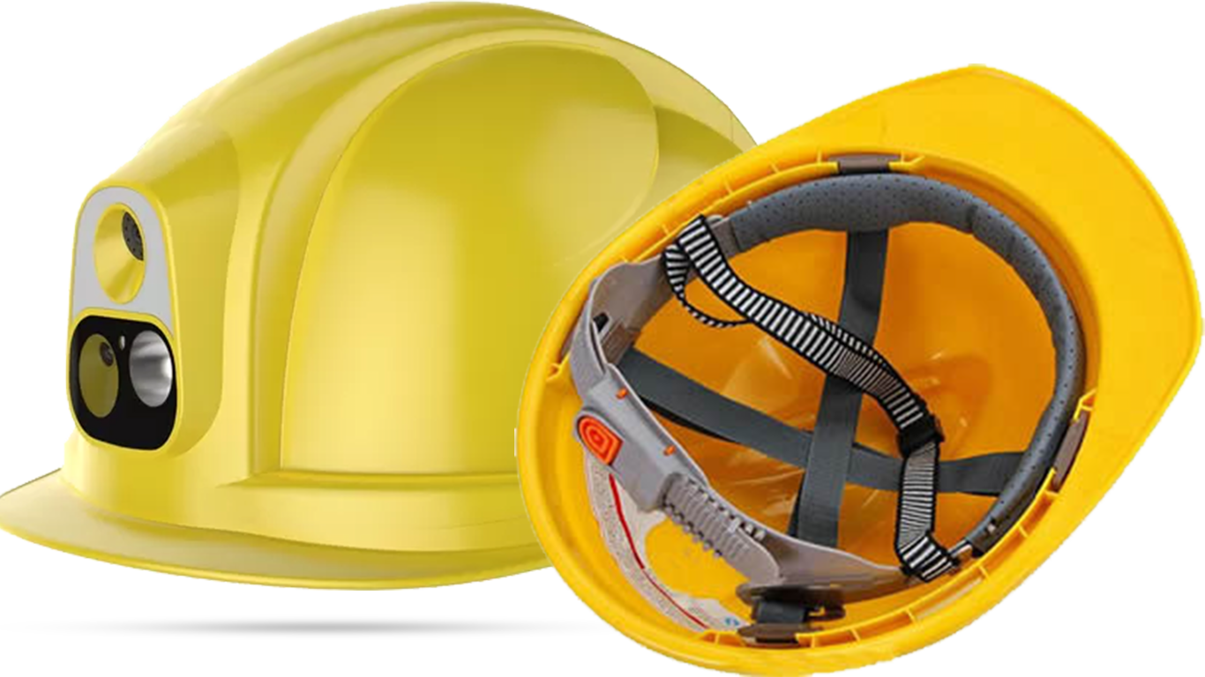
Wearable Electronics
Wearable electronic devices are small devices worn on the head, neck, arms, torso, and feet.
Current smart wearable devices include −
Head − Helmets, glasses
Neck − Jewelry, collars
Arm − Watches, wristbands, rings
Torso − Clothing, backpacks
Feet − Socks, shoes

Slide 11
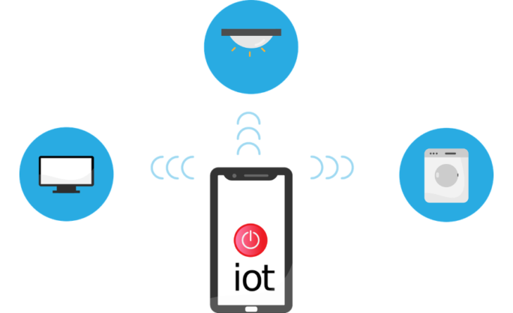
Standard Devices
Desktop, tablet, and cellphone remain integral parts of IoT as the command center and remotes.
•Desktop- provides the user with the highest level of control over the system and its settings.
•Tablet- provides access to the key features of the system in a way resembling the desktop, and also acts as a remote.
•Cellphone- allows some essential settings modification and also provides remote functionality.

Slide 12
Software

Slide 13
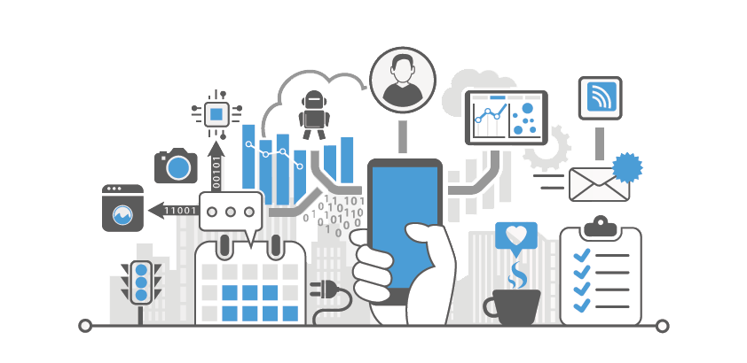
IoT (Internet of Things) software refers to the specialized applications and platforms that enable the management, communication, and control of IoT devices and data. These software solutions play a crucial role in making IoT systems functional, secure, and scalable.
IoT Platforms, Device Management Software, Data Analytics and Visualization Tools, Edge Computing Software, Cloud Computing Services, Security Solutions, Communication Protocols, IoT Application Development Platforms, Predictive Maintenance Software, IoT Simulation and Testing Tools
common types of IoT software include

Slide 14
Technology and Protocols

Slide 15
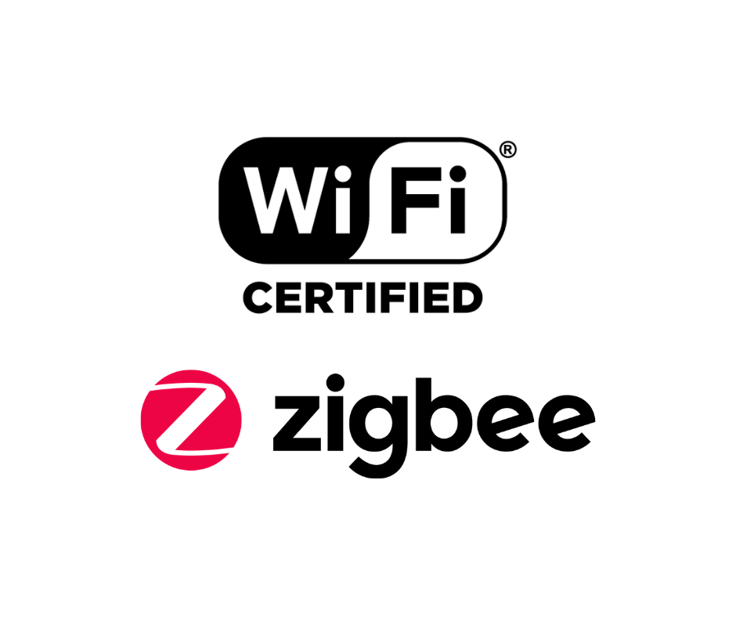


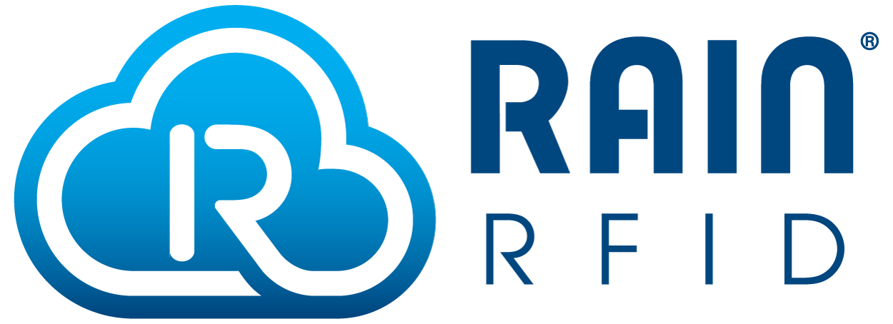
The major enabling technologies and protocols of IoT are RFID, NFC, low-energy Bluetooth, low-energy wireless, low-energy radio protocols(ZigBee, Z-Wave), LTE-A, and WiFi-Direct. These technologies support the specific networking functionality needed in an IoT system in contrast to a standard uniform network of common systems.

Slide 16
How dose IoT Work?

Slide 17
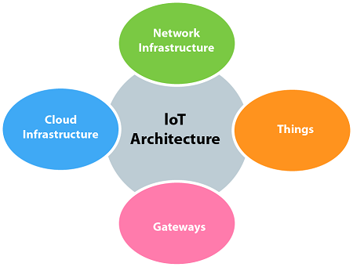
The entire working process of IoT starts with the device themselves, such as smartphones, digital watches, electronic appliances, which securely communicate with the IoT platform. The platforms collect and analyze the data from all multiple devices and platforms and transfer the most valuable data with applications to devices.

Slide 18
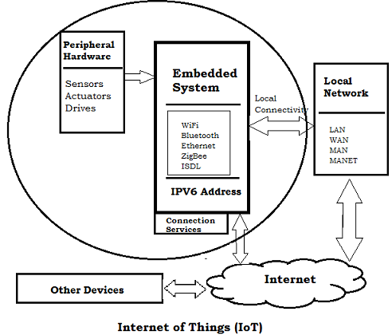
Embedded Device In IOT
The embedded devices are the objects that build the unique computing system. These systems may or may not connect to the Internet.
An embedded device system generally runs as a single application. However, these devices can connect through the internet connection, and able communicate through other network devices.

Slide 19
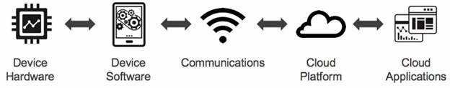
IOT Decision Framework
The IoT decision framework is much more important as the product or services communicates over networks goes through five different layers of complexity of technology.
The IoT decision framework provides a structured approach to create a powerful IoT product strategy.
Device Hardware
Device Software
Communications
Cloud Platform
Cloud Application

Slide 20
The IoT decision framework pays attention to six key decision areas in any IoT product. These decision areas are:
User Experience (UX) decision area - concentrate about who are the users
Data decision area - make the overall data strategy such as the data flow over the entire IoT stack to fulfill the user's requirements.
Business decision area - make the decision how product or services will become financial potential, IoT Stack level are monetized about the costs of providing services
Technology decision area- work with the technology for each layer to facilitate the final solution
Security decision area - important to decide and provide the security at each stage of the IoT Stack
Standards & Regulations decision area - last stage of IoT Decision Area, identify the standards and regulations of product or services
Each of these decision areas is evaluated at each of the IoT Technology Stack.

Slide 21
Applications and Architecture Domain

Slide 22
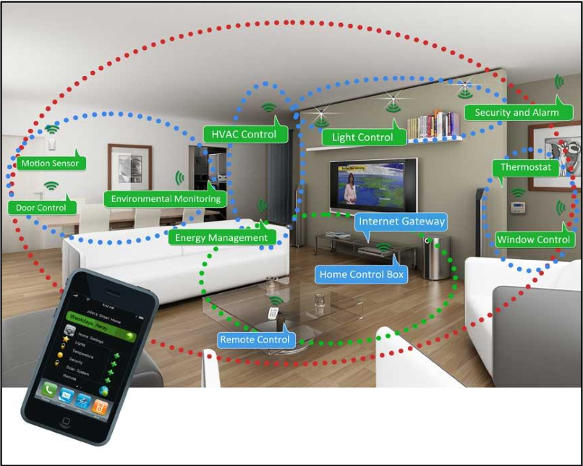
Residential Energy
IoT provides a mature way to analyze and optimize the use of the device as well as the entire system of a home. It may be changing the device setting, simply switching on/off or dimming lights to optimize energy use.

Slide 23
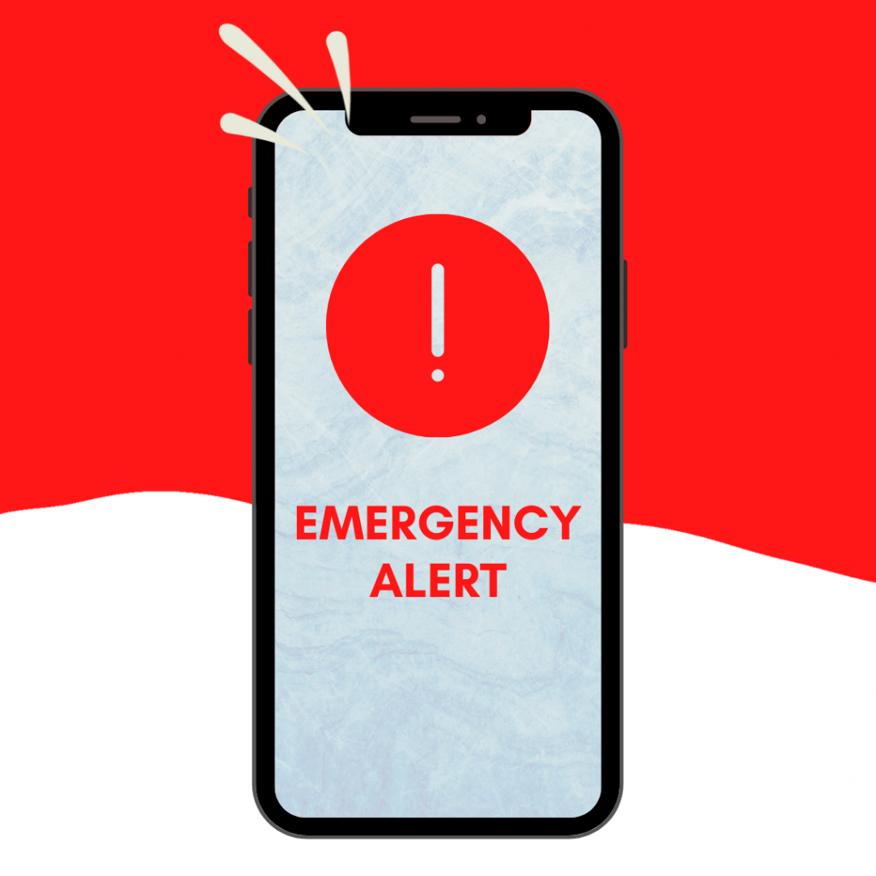
how IoT is used in residential energy processes
Smart Metering: IoT-enabled smart meters are used to measure and record electricity, gas, and water consumption in real-time.
Home Automation: IoT devices can automate various processes in homes, such as controlling lights, thermostats, and appliances remotely
Smart Thermostats: IoT-based smart thermostats learn household patterns and adjust temperature settings accordingly. They can be controlled remotely through smartphones, optimizing energy consumption for heating and cooling systems.
Energy Monitoring Systems
Demand Response: IoT-enabled demand response systems allow utility companies to communicate with home devices during peak demand periods
Predictive Maintenance: IoT sensors can monitor the health of appliances and notify homeowners about potential issues
Data Analytics: IoT-generated data is analyzed to identify trends and patterns in energy consumption

Slide 24
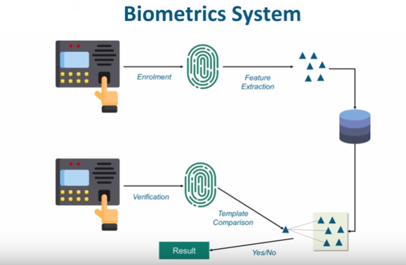
Biometrics Domain
IoT plays a vital role in the Biometrics security system such as a fingerprint system, voice recognition system, eye scanner system etc.Either use a fingerprint sensor or an eye-scanning system, depends on organization to organization.
When a person presents its finger on the fingerprint scanner it scans the fingerprint and considers this as part of an enrollment process. From this fingerprint template, the device extracts certain key features which make different from others and stores it into a database.
After that, every time the same person place its finger on the top of this fingerprint scanner, it creates a template and compares this with all the templates that are present in the database. If it matches to correspondingly let's say giving that person an attendance or allows him to access a door, if it does not then it raises an alert.
This biometric system can be fingerprint or eye scanning or it could be a combination of both. Voice recognition system is also one of the key products in the biometric domain.

Slide 25
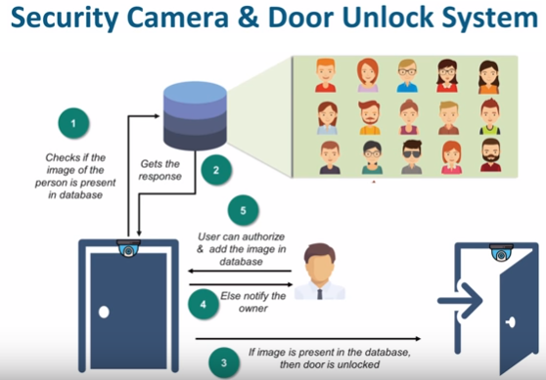
IoT in Security Camera & Door Unlock System

Slide 26
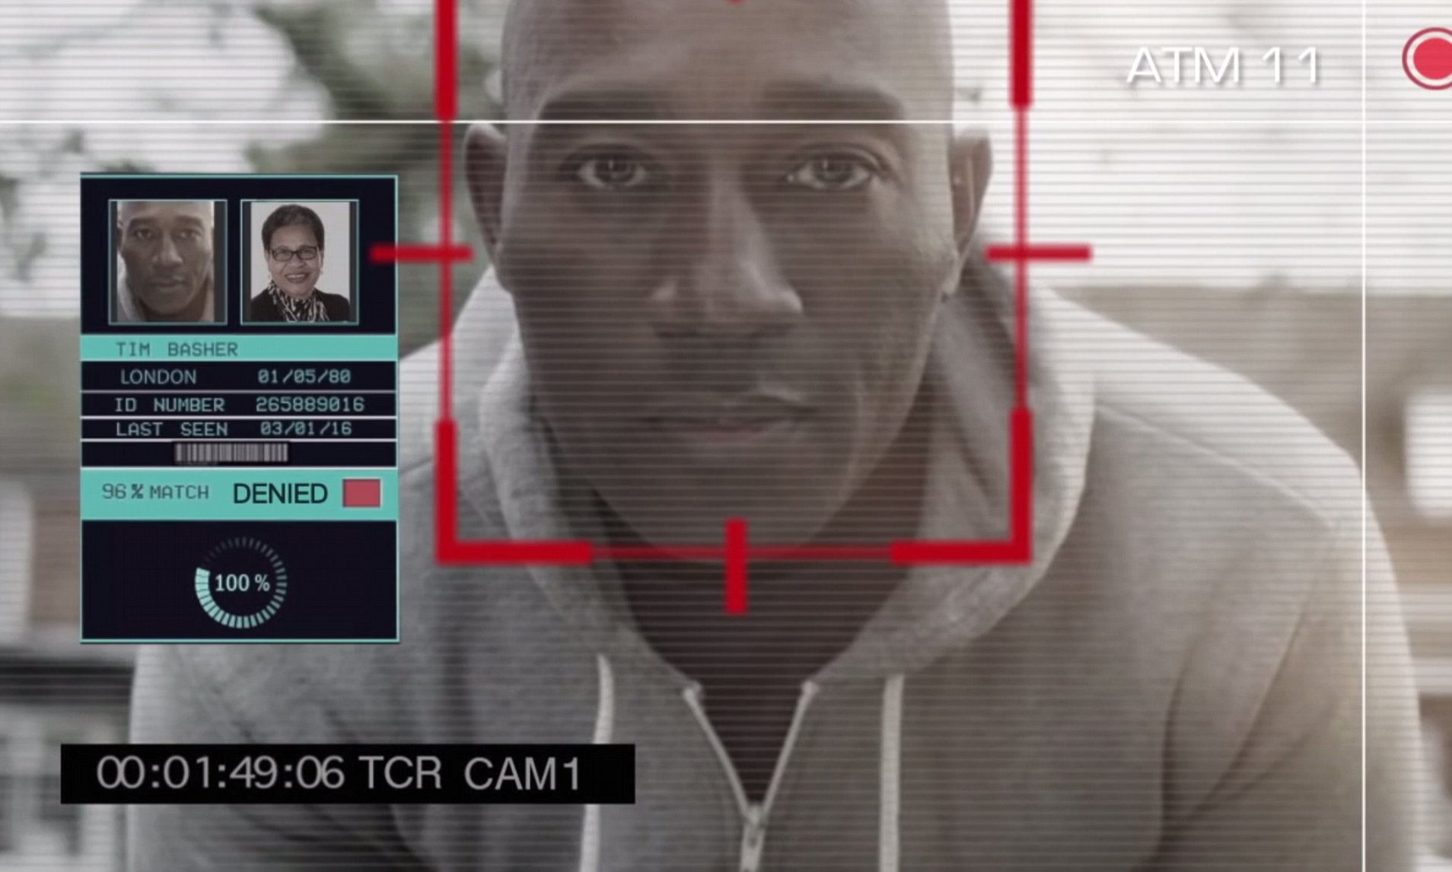
Place a camera on the top foot of the door which in turn clicks the photo of a person who comes into frame.
Now, this photo is sent to an analytical system which in turn compares this with all the photos it possesses to identify whether to let the user open the door or not.
Now, if it does not find the photo of that person then it can notify the concern that a person is trying to access this door would you like to authorize this person? or would you like to deny the access to this person?
Usually, the Security Camera and a Door unlock system is used in the areas where you have highly sensitive information stored.
Another usage of the security camera and door unlock system can be at our homes when we want to identify who comes to our home when we are not there and either decide to give them access to our home or not.
Also we can use AI for recognize the person

Slide 27
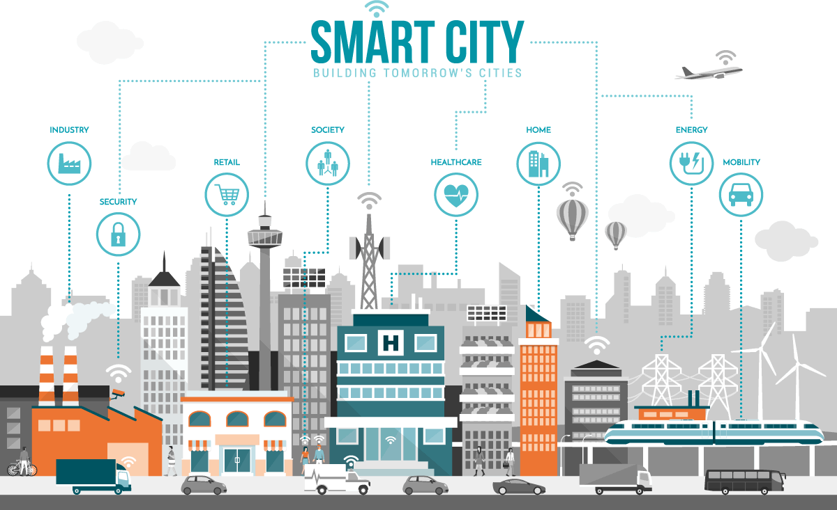
Smart City
The smart city is an evolution of a smart home. Here, it is not just the sensors of a single home that is connected, here its correlation or a network or a connection between various organizations, various domains as well as multiple segments of that city as a whole. In the smart city, the life of every single dependent becomes more comfortable and in tune really help to develop that city to greater extends as such.

Slide 28
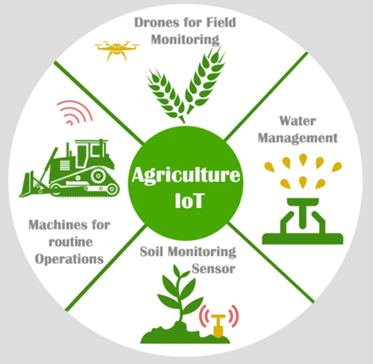
Smart Agriculture Domain
IoT system plays vital role for soil and crop monitoring and provides a proper solution accordingly.
Using smart farming through IoT technologies helps farmer to reduce waste generation and increase the productivity.
There are several IoT technologies available that work on agriculture domain. Some of them are:
Drones for field monitoring
Sensor for soil monitoring
Water pump for water sully
Machines for routine operation

Slide 29
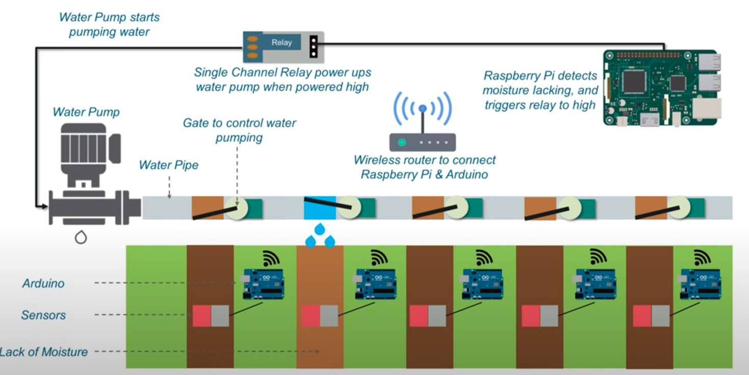
Smart Agriculture -Smart Irrigation System

Slide 30
In the smart irrigation system, IoT checks the moisture level in the environment or in the water lanes that the farmer has created.
Usually, the two main IoT devices that used here is the Arduino board and the Raspberry Pi. The Raspberry Pi becomes the main processing unit, and an Arduino board is placed from each of water channels. These Arduino boards themselves connect to multiple sensors which are part of this water channel so what these sensors check the moisture present in these lanes as such.
specific lane does not meet the minimum required moisture then the Arduino board would send a signal to the Raspberry Pi. Again all these devices are connected on the same wireless router network, and the Raspberry Pi would identify the lack of moisture and pass a signal to the relay. The relay, in turn, would initiate the water pump and the water would be parked now to ensure that water is not wasted. The smart irrigation system would be a gate control system and only that gate will open where the moister is less. Once the sensors detect that the moisture level has gone beyond the required limit, it would again transmit another signal to the Raspberry Pi asking it to stop the pump as well. So, this helps a farmer to save a lot of water and also makes life quite easier as well. So, after this, the farmer only task is to either setting up new plans or creating new water channels.

Slide 31
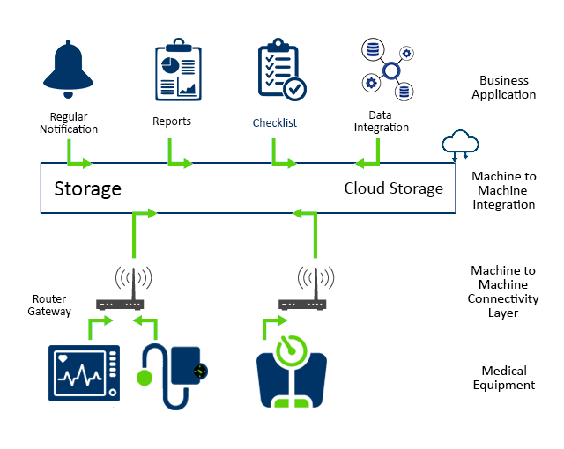
Healthcare System
Remote monitoring to smart sensors to medical device integration. It keeps the patients safe and healthy as well as improves the physician delivers care towards the patients. Healthcare devices collect diverse data from a large set of real-world cases that increases the accuracy and the size of medical data

Slide 32
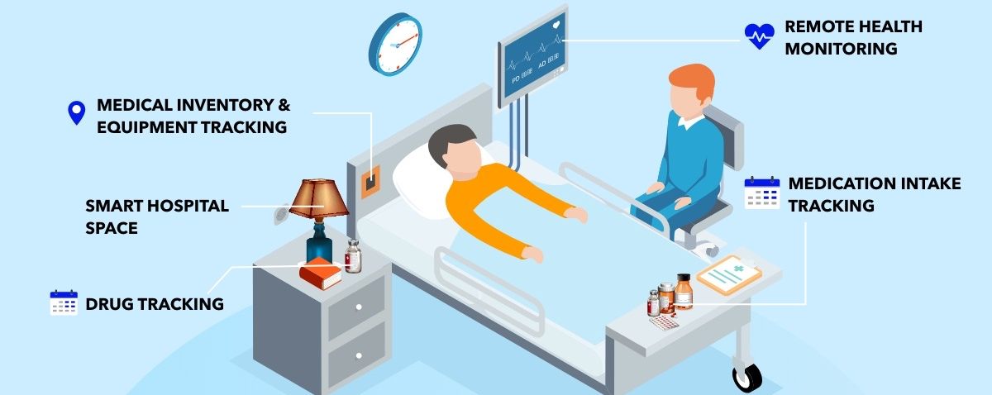
Product Infrastructure: IoT product infrastructure such as hardware/software component read the sensors signals and display them to a dedicated device.
Sensors: IoT in healthcare has different sensors devices such as pulse-oximeter, electrocardiogram, thermometer, fluid level sensor, sphygmomanometer (blood pressure) that read the current patient situation (data).
Connectivity: IoT system provides better connectivity (using Bluetooth, WiFi, etc.) of devices or sensors from microcontroller to server and vice-versa to read data.
Analytics: Healthcare system analyzes the data from sensors and correlates to get healthy parameters of the patient and on the basis of analyze data they can upgrade the patient health.
Application Platform: IoT system access information to healthcare professionals on their monitor device for all patients with all details.

Slide 33
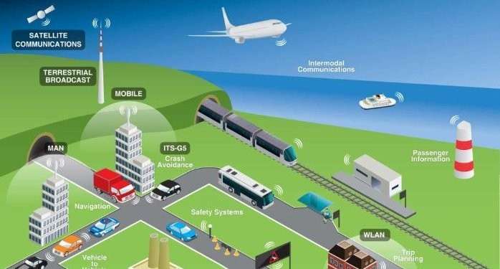
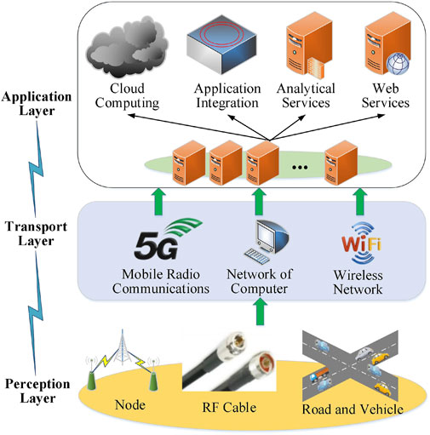
Transportation

Slide 34
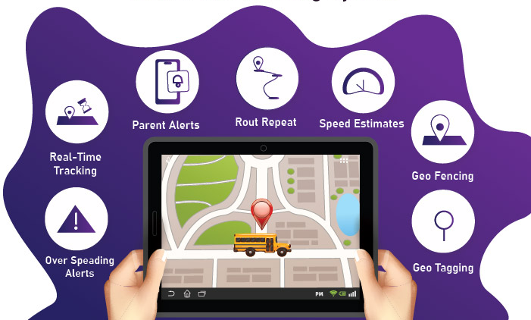
IoT plays an important role in all the field of transportation as air-transportation, water-transportation, and land transportation. All the component of these transportation fields is built with smart devices (sensors, processors) and interconnected through cloud server or different servers that transmit data to networks.
IoT in transportation is not only for traveling from one place to another, but it also makes safer, greener and more convenient. For example, a smart car performs work simultaneously such as navigation, communication, entertainment, efficient, more reliable travel. IoT facilitates travelers to remain seamlessly connected to every means of travel. The vehicle is connected with the variety of wireless standards to the internet such as Bluetooth, Wi-Fi, 3G, 4G, intelligent traffic system, and even to other vehicles.

Slide 35
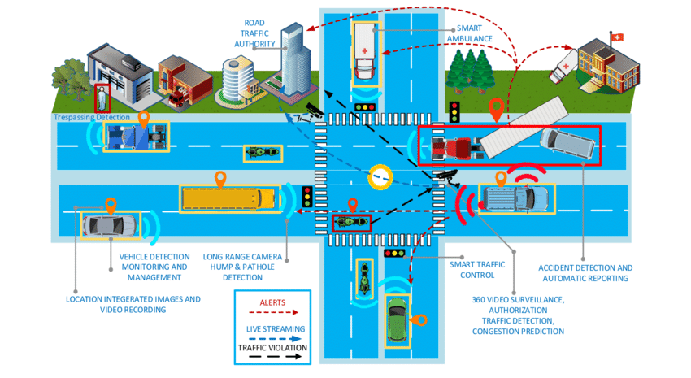
Traffic Monitoring and Avoid Collision
Sensors built inside or outside a vehicle suggest lane departure and continuously monitor object at all side to avoid the collision. IoT component of transportation does not only mean within the vehicle, but it extends beyond car to communicate other, enabling automate real-time decision to optimize travel. For example, traffic monitoring camera identifies the accident or traffic conjunction and send an alert message to the nearest traffic control room and send current traffic conjunction information to other near vehicles to divert their route.

Slide 36
IIOT - The industrial internet of things

Slide 37
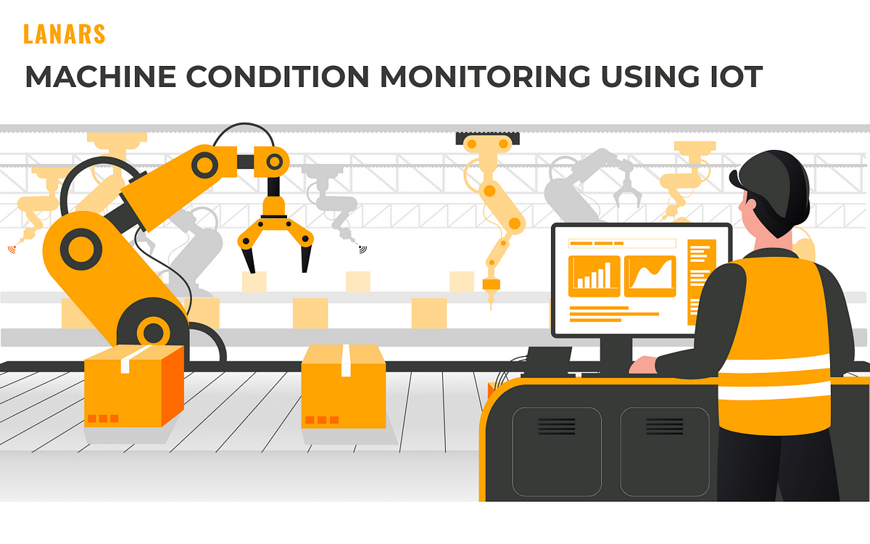
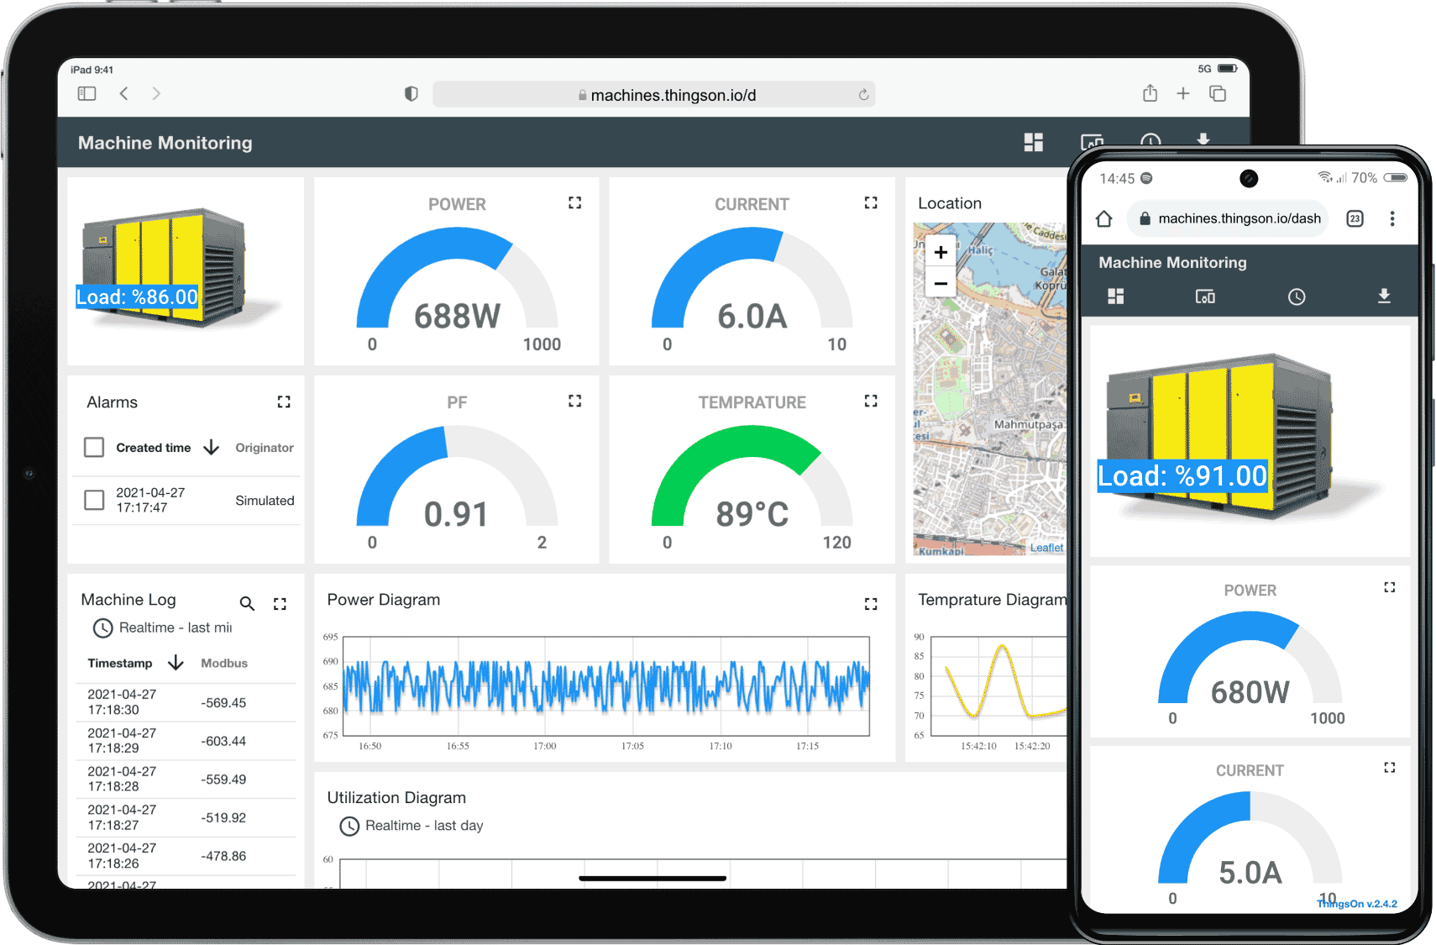
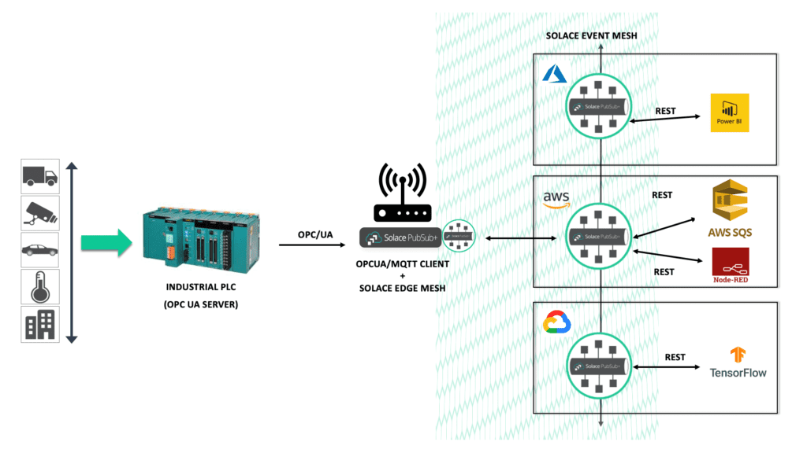
Building IOT Real-time monitoring system with PLC

Slide 38
Define Project Requirements- : Determine the specific industrial process or application you want to monitor and control
Select PLC Hardware - Choose a suitable PLC with the required input/output (I/O) capabilities to interface with sensors and actuators. Ensure that the PLC supports communication protocols like Modbus or Ethernet/IP for IoT integration.
Choose IoT Devices
Design Sensor Interface- Create a circuit to interface the IoT sensors with the PLC
Connect IoT Devices to PLC
Program the PLC
Set Up Cloud Platform
Integrate IoT Cloud with PLC
Implement Real-time Monitoring- Configure the IoT cloud platform to enable real-time data visualization and monitoring
Data Analytics and Visualization - Set up data analytics services on the cloud platform to process the historical data collected from the IoT devices
Implement Control and Automation Rules - Utilize the cloud platform's rule engine to implement automation rules and predictive maintenance algorithms
Test and Deploy- Thoroughly test the integrated system to ensure the PLC, IoT devices, and cloud platform work together seamlessly. Deploy the system to the production environment and monitor its performance over time.
Continuous Improvement - Monitor the system's performance, collect feedback, and analyze data to identify opportunities for improvement. Continuously refine the system to enhance its efficiency, reliability, and overall performance.

Slide 39
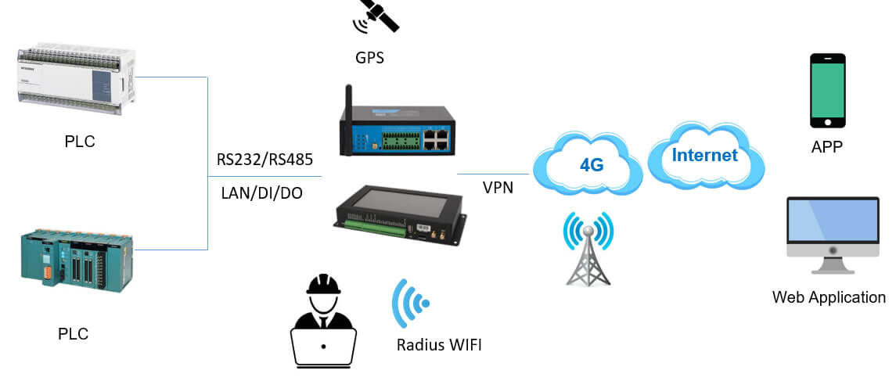
PLC Gateway
PLC gateway plays a crucial role in enabling seamless communication between the industrial control network and other networks or cloud platforms. It facilitates data exchange, improves connectivity, and enhances the overall efficiency of industrial automation and monitoring systems. Gateway serves as an intermediary or bridge between the industrial control network (where PLCs are located) and other networks, such as the Internet, local area networks (LAN), or cloud-based platforms. Its primary function is to enable communication and data exchange between different systems.

Slide 40
IOT Tools and Technologies

Slide 41
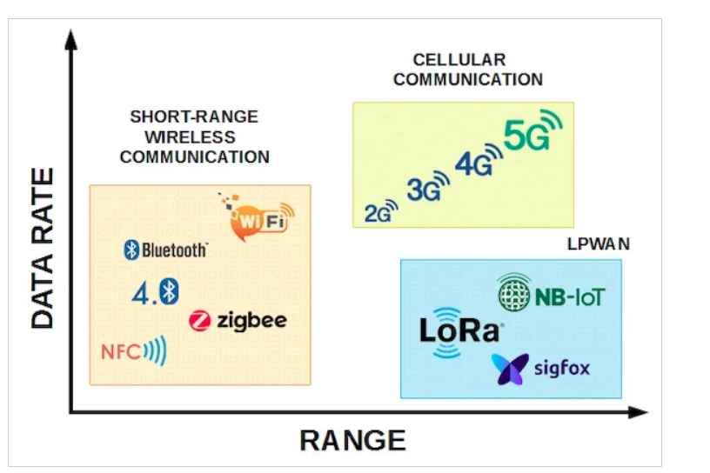
Connectivity Protocols: These protocols facilitate communication between IoT devices and the central data platform. Examples include Wi-Fi, Bluetooth, Zigbee, Z-Wave, LoRaWAN, cellular (2G/3G/4G/5G), and NB-IoT (Narrowband IoT).
IoT Platforms: IoT platforms provide the infrastructure for device management, data collection, storage, and analysis. They often include features for security, device provisioning, and integration with other systems. Examples of IoT platforms include Microsoft Azure IoT Hub, AWS IoT Core, Google Cloud IoT Core, and IBM Watson IoT Platform.

Slide 42
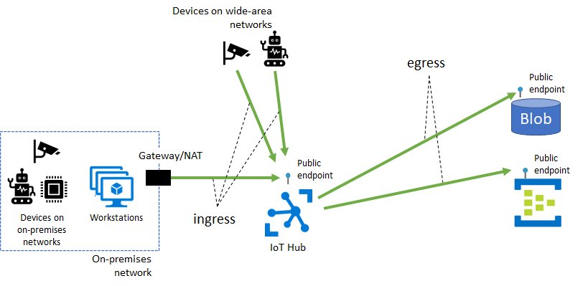
EX- Azure hub connect with device

Slide 43
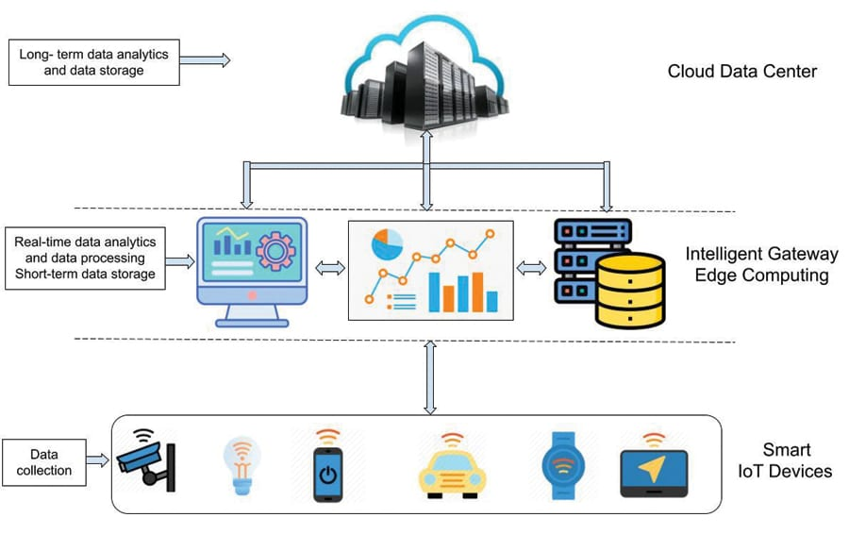
Edge Computing - Edge computing brings data processing closer to the data source (IoT devices) instead of sending all data to a centralized cloud server. It reduces latency, bandwidth usage, and enhances real-time processing. Examples include EdgeX Foundry and AWS IoT Greengrass.
Architecture -

Slide 44
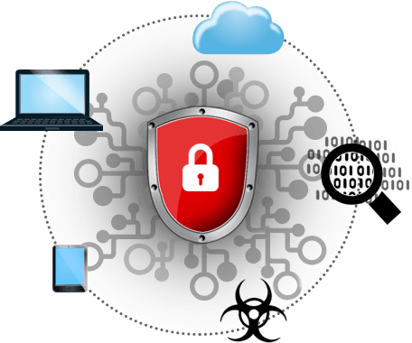
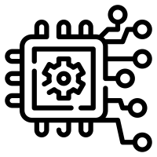
IoT Sensors: A wide variety of sensors, such as temperature, humidity, pressure, motion, and light sensors, are used to collect data from the physical world.
Embedded Systems: Embedded systems are specialized computing systems integrated into IoT devices to control and monitor various functions. They are responsible for executing the device's operations and communicating with other devices or the cloud.
IoT Security Solutions: As IoT devices can be vulnerable to security threats, IoT security solutions provide measures like authentication, encryption, access control, and firmware updates to protect devices and data.

Slide 45
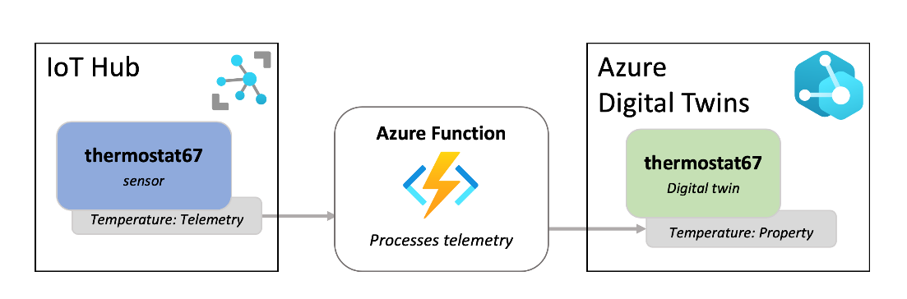
7. Big Data Analytics: IoT generates vast amounts of data, and big data analytics tools are used to process and extract valuable insights from this data. Technologies like Apache Hadoop, Apache Spark, and Elasticsearch are common choices.
8. Machine Learning and AI: AI and machine learning algorithms are employed to make sense of IoT data, enable predictive maintenance, and optimize processes. TensorFlow, PyTorch, and scikit-learn are popular libraries for implementing machine learning models.
9. Digital Twins: Digital twins are virtual representations of physical assets or systems. They enable simulations, analytics, and predictive maintenance for real-world objects. Companies like Siemens Mind sphere and Microsoft Azure Digital Twins offer digital twin platforms.

Slide 46
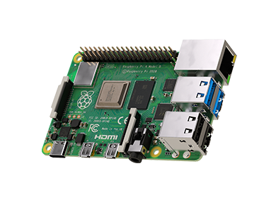
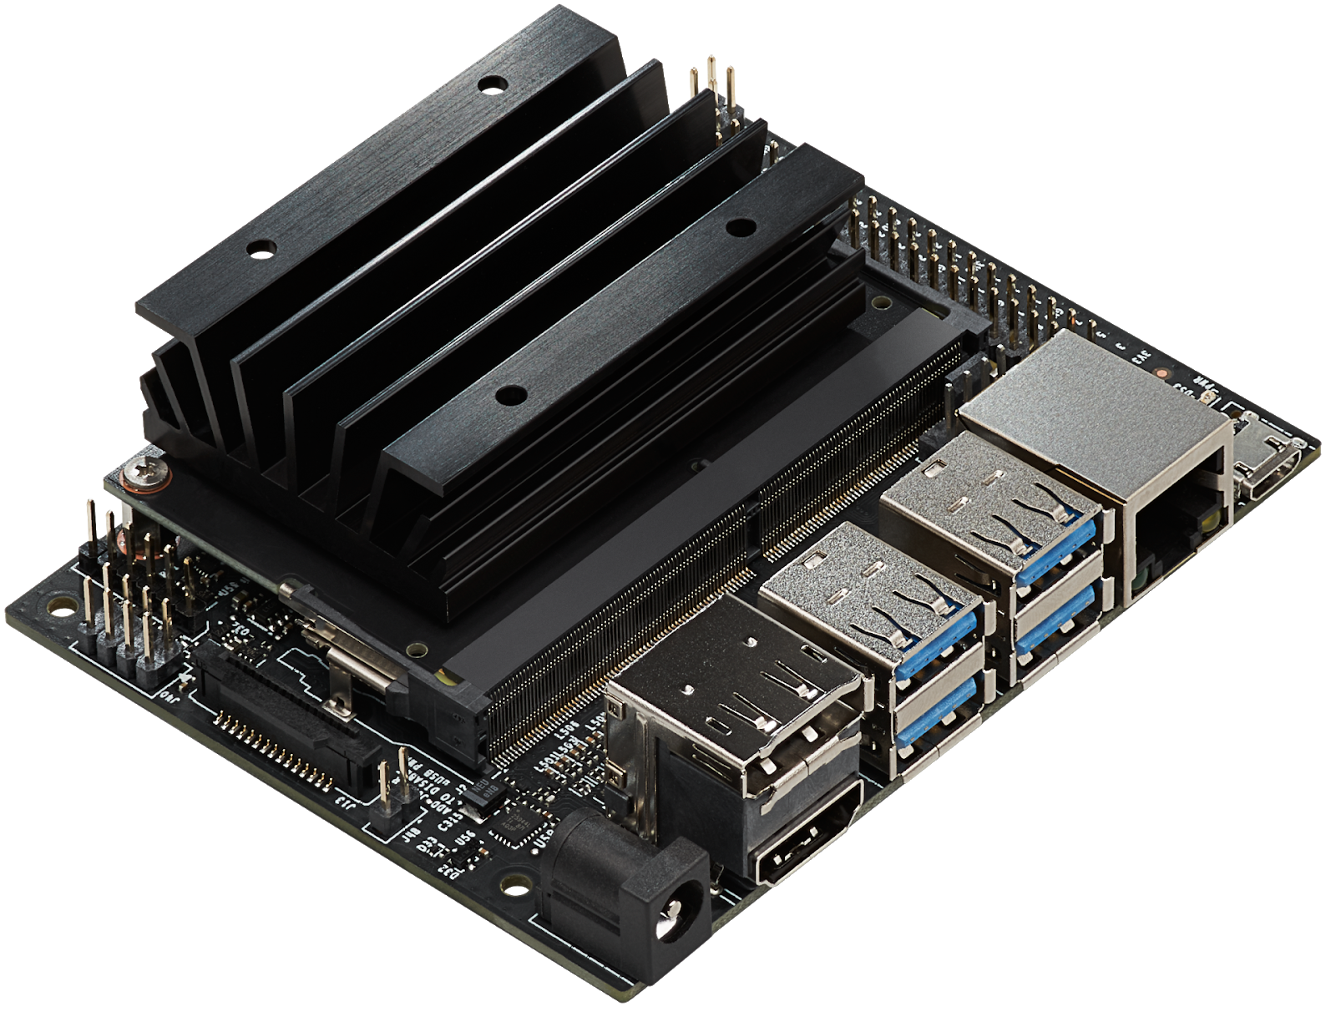
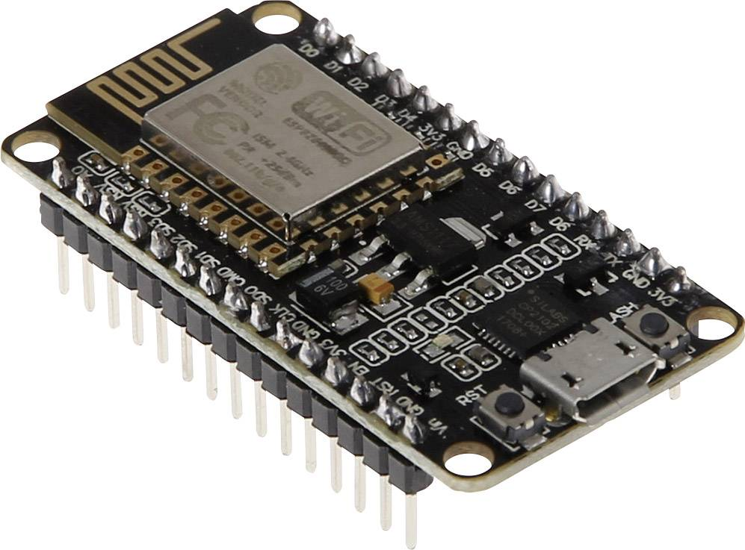
10. Cloud Computing: Cloud services offer scalable and cost-effective storage and computing resources for IoT data and applications. Leading cloud providers include AWS, Microsoft Azure, Google Cloud, and IBM Cloud.
11. IoT Development Kits: IoT development kits provide a hardware and software platform for developers to quickly prototype and build IoT applications. Examples include Arduino, Raspberry Pi, and Particle.
Other examples - ESP8266 and ESP32 IoT Kits, Particle IoT Kit, Intel IoT Developer Kit, Microsoft Azure Sphere, Google Coral IoT Kit, NVIDIA Jetson Nano, Mbed IoT Starter Kit, Seeed Studio Grove IoT Starter Kit
ESP8266
Raspberry pi
Nvidia Jetson

Slide 47
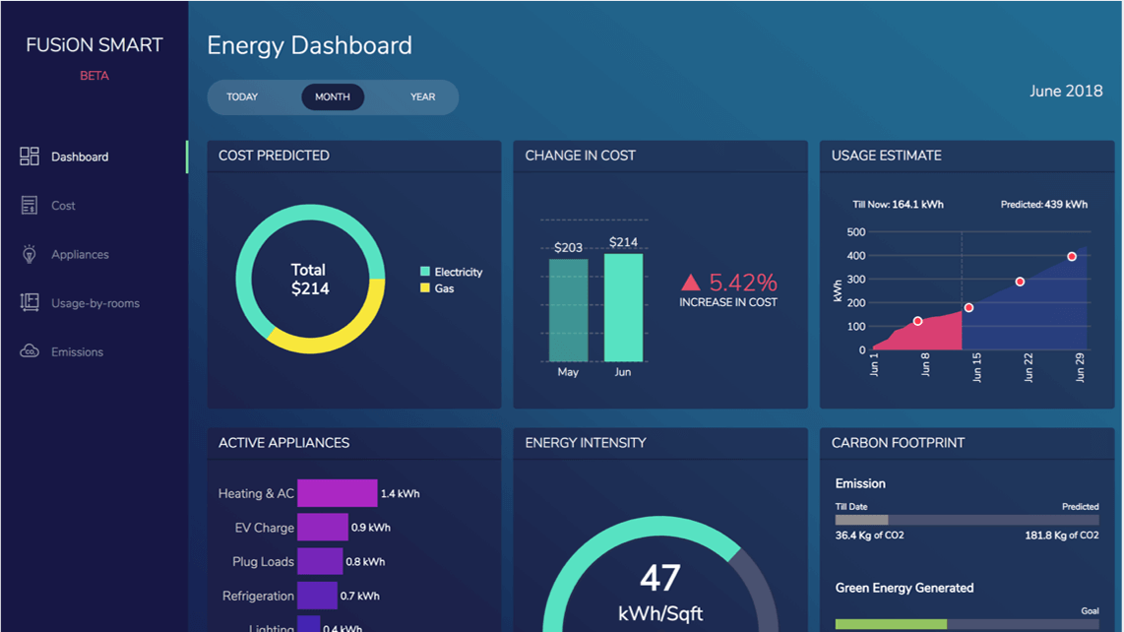
IOT visualization
IoT visualization is crucial as it transforms complex data from connected devices into clear and actionable insights. By presenting information through intuitive graphs, charts, and dashboards, it enables better decision-making, early detection of anomalies, and improved operational efficiency. Visualization empowers businesses to understand real-time IoT data quickly and identify trends, patterns, and potential issues, leading to enhanced productivity, cost savings, and a competitive advantage in the rapidly evolving IoT landscape.
Ex- Grafana, Kibana, Tableau, Microsoft Power BI, Node Red , ThingSpeak, Blynk, ThingWorx

Slide 48
IOT Advantages

Slide 49
Improved Customer Engagement- Personalization, Predictive Analytics, Seamless User Experience, Real-time Feedback and Support, Enhanced Product Interactivity, Smart Customer Service, Loyalty Programs and Rewards, Location-based Marketing, Improved Supply Chain and Inventory Management, Data-Driven Decision Making
Technology Optimization - The same technologies and data which improve the customer experience also improve device use, and aid potent improvements to technology. IoT unlocks a world of critical functional and field data.
Reduced Waste - IoT makes areas of improvement clear and Current analytics give superficial insight.
Enhanced Data Collection

Slide 50
IOT Disadvantage

Slide 51
Security - IoT devices often lack robust security measures, vulnerable to cyberattacks unauthorized access to sensitive data or take control of devices.
Privacy - IoT devices collect vast amounts of data about users and their behaviors. The misuse or mishandling of this data can raise serious privacy concerns. Users may feel uncomfortable knowing that their personal information is being collected and used without their explicit consent.
Complexity and Maintenance- deployment and management of IoT devices can be complex. As the number of connected devices grows, maintaining and updating them can become labor-intensive and expensive.
Reliability and Downtime- IoT devices rely on stable internet connectivity to function correctly. Network outages or disruptions can lead to device downtime, affecting the overall user experience and causing inconvenience to customers.
Power Consumption- Many IoT devices are battery-powered, and optimizing power consumption is crucial for their efficiency and longevity. battery replacements added costs.
Cost - devices can be expensive
Data Overload - The sheer volume of data generated by IoT devices can be overwhelming for organizations to manage and analyze effectively. Without proper data analytics tools and strategies, valuable insights may be lost in the sea of information

Slide 52
Thank You.!!!

